Slide 1
CMPE493: Introduction to IR Term Project: Named Entity Normalization for the Bacteria Biotopes Domain
Mansur YeşİLBursa
Abdullah Yıldız
Can Devecİ

Slide 2
Overview
Part 1: Mansur_part_name, Mansur Yeşilbursa
Part 2: Abdullah_part_name, Abdullah Yıldız
Part 3: Future Work, Can Deveci

Slide 3
Mansur_part_name

Slide 4
Mansur_part_name

Slide 5
Abdullah_part_name

Slide 6
Abdullah_part_name

Slide 7
Future Work
Researched Habitats Domain NER Papers List
Researched Biomedical Domain NER Papers List
Fused List
Ease in Implementation
Computational/Hardware Concerns
Relatedness to our goals

Slide 8
Paper 1 [1]
A smarter utilization of existing dictionaries
Brenda Tissue Ontology, 121321 habitat synonyms
E.g. the term “central nervous system” (OBT:000831) was expanded to include “hippocampus” and 2748 other terms
Problem with dictionary-based NER:
Prone to poor precision, especially after automatic dictionary expansion
Solution
Stopword lists are used to remove matches that contribute the most to the drop in precision
Criteria: removing those terms that were likely to not decrease true positive matches
E.g. unclassified, scales, root
Again, found existing dictionaries

Slide 9
Paper 2 [4]
Preprocessing
Acronym expansion: already done
Abbreviation expansion: already observed defect
Stemming: Porter stemmer [17] (we do not expect a better result [4])
Improving TDIDF, weighted sparse vector space representation
Each concept name in the ontology is considered a document and the IDF weights are based on these names
each concept name and each entity mention is represented with a TFIDF weighted vector and the concept with the highest cosine similarity is assigned for a given entity
Whereas these representations are commonly formed in a bag-of-words fashion
Using character-level n-grams (n=1,2,3 ) will probably result in better outcome [4]

Slide 10
Paper 3 [2]
Conditional Random Field (CRF) based classifier [2]
a type of discriminative and undirected probabilities graphical models often used for tagging sequential data and in named entity recognition in natural language processing and biology domains
Features for the CRF model
Lexical features such as current word, its root, its POS tag etc. GeniaTagger [16] may be used.
Orthographic features: substring and word form features
Substring features: first two & four characters and the last two & four characters of the original word and the word form are chosen as features
this was already mentioned in the lectures, using first k chars may work better than hard lemmatization
Word form features: case-folding and/or normalizing all numbers to ‘0’
Dictionary features: binary features to indicate
the presence of the word in the dictionary
the position of the word within any dictionary entries

Slide 11
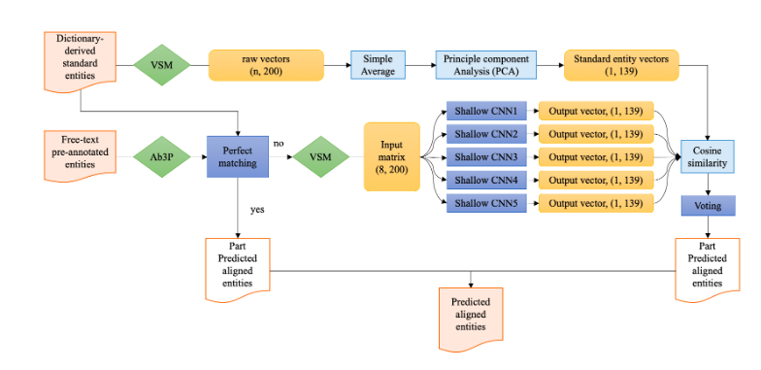
Idea 3
Authors originally used Mallet (a Java implementation)
We may change toolkit or implementation
For Python implementation (https://github.com/TurkuNLP/BHE) [3]
Or, Employing a hybrid (rule-based & ML based) structure such as
Figure 1: Model Architecture Overview [10]

Slide 12
Habitats Domain NE Normalization Papers
[1] A dictionary- and rule-based system for identification of bacteria and habitats in text
[2] Automatic extraction of microorganisms and their habitats from free text using text mining workflows
[3] Detection and categorization of bacteria habitats using shallow linguistic analysis
[4] End-to-End System for Bacteria Habitat Extraction
[5] Linking entities through an ontology using word embeddings and syntactic re-ranking

Slide 13
Biomedical Domain NE Normalization Papers
[6] A Survey on Recent Advances in Named Entity Recognition from Deep Learning models
[7] Normalizing biomedical terms by minimizing ambiguity and variability
[8] NERBio: using selected word conjunctions, term normalization, and global patterns to improve biomedical named entity recognition
[9] A method for named entity normalization in biomedical articles application to diseases and plants
[10] An ensemble CNN method for biomedical entity normalization
[11] CNN-based ranking for biomedical entity normalization
[12] DNorm disease name normalization with pairwise learning to rank
[13] OrganismTagger detection, normalization and grounding of organism entities in biomedical documents
[14] Unsupervised geneprotein named entity normalization using automatically extracted dictionaries
[15] A. K. McCallum. MALLET: A Machine Learning for Language Toolkit. http://mallet.cs.umass.edu, last accessed 08 July 2011.
[16] Tsuruoka, and J. Tsujii. Bidirectional Inference with the Easiest-First Strategy for Tagging Sequence Data. In Proceedings of HLT/EMNLP, 2005.
[17] Martin F Porter. 1980. An algorithm for suffix strip-ping.Program14(3):130–137.

Slide 14
Thanks

